Slide 1
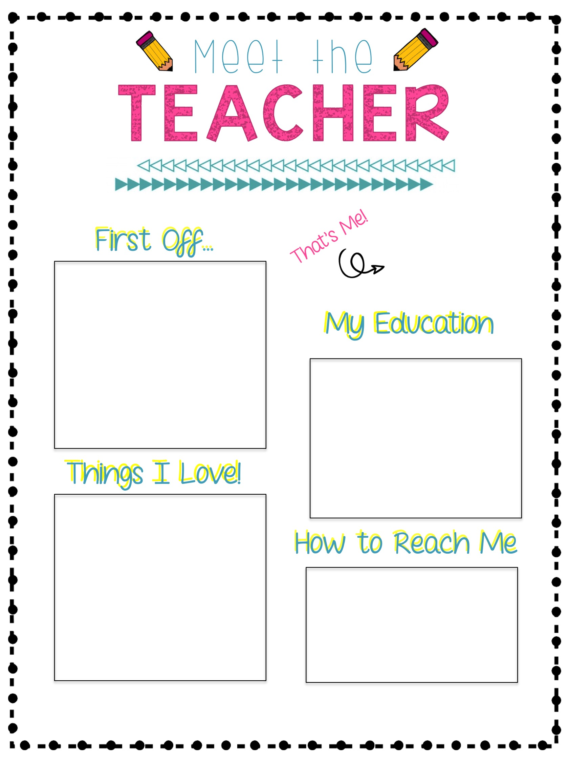
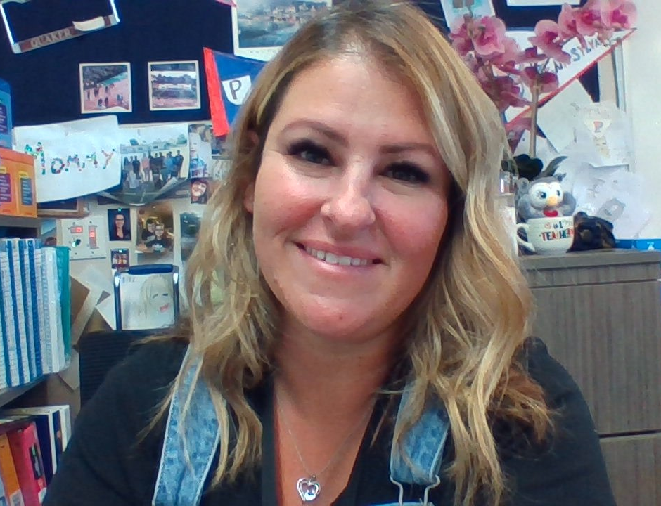
Hi! My name is Mrs. Colca and I will be your child’s 6th grade teacher. I love sixth-grade and am looking forward to another exciting school year. This will be my 9th year as part of the Cattle family and 8th in sixth grade. I have a great husband, three kids and a one-year-old Goldendoodle named Otis. I'm excited to help make your child's final year at Cattle a great one!
I attended Temple City schools K – 12. After graduating high school, I attended Citrus College and then transferred to Cal Poly Pomona, earning my Bachelors in Liberal Studies. Go Broncos! I continued my education there and earned my Multiple Subject Teaching Credential. I have since taken classes through UCSD to further my education.
Food: Sushi
Fast Food: Chipotle
Book: The Five People You Meet in Heaven
Flower: Orchid
Store: Target or Kohl’s
Season: Fall
Hobbies: boating, camping, reading, traveling, going to concerts, watching Bravo shows and spending time with family and friends ☺
You can contact me at:
Phone: (909) 591-2755
Email:
sarah_colca@chino.k12.ca.us
Class Dojo: Individual link will be sent home

